Slide 1

MEMORY MANAGEMENT ANALYZER
Operating Systems Project
Submitted by: Musa Bin Abdullah (233576) Muhammad Danial (233588)
Submitted to: Sir Mughees
Air University - 2025

Slide 2
PROJECT OVERVIEW
- Interactive web-based simulation platform
- Visualizes memory allocation algorithms in real-time
- Allows comparison of 5 different algorithms
- Educational tool for OS concepts
KEY FEATURES:
✓ Real-time visualization
✓ Multiple allocation algorithms
✓ Interactive process generation
✓ Performance metrics
✓ Cloud deployment

Slide 3
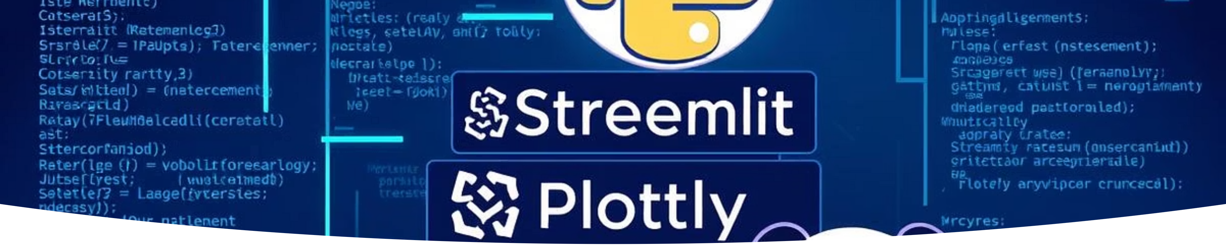
TECHNOLOGY STACK
Frontend & Backend:
Core Modules:
Python 3.8+
memory_simulator.py - Algorithm implementation
Streamlit (Web Framework)
memory_visualizer.py - Visualization components
Plotly (Visualization)
process_generator.py - Process creation
Pandas (Data Analysis)
streamlit_app.py - Main application

Slide 4


5 ALGORITHMS IMPLEMENTED
FIRST FIT
BEST FIT
WORST FIT
Allocates to first available block
Finds smallest sufficient block
Uses largest available block
Maximizes memory utilization
Leaves large free spaces
Fastest for allocation
NEXT FIT
BUDDY SYSTEM
Continues from last allocation
Power-of-2 blocks
Even distribution
Fast allocation/deallocation

Slide 5



INTERACTIVE FEATURES
PROCESS GENERATION
VISUALIZATION
CONTROLS
Manual mode (custom size/duration)
Real-time memory map
Algorithm selection
Fragmentation charts
Memory size configuration
Batch mode (5/10 random processes)
Process details table
Individual process deallocation
Live statistics
Bulk clear operations
Auto-generation (configurable interval)

Slide 6
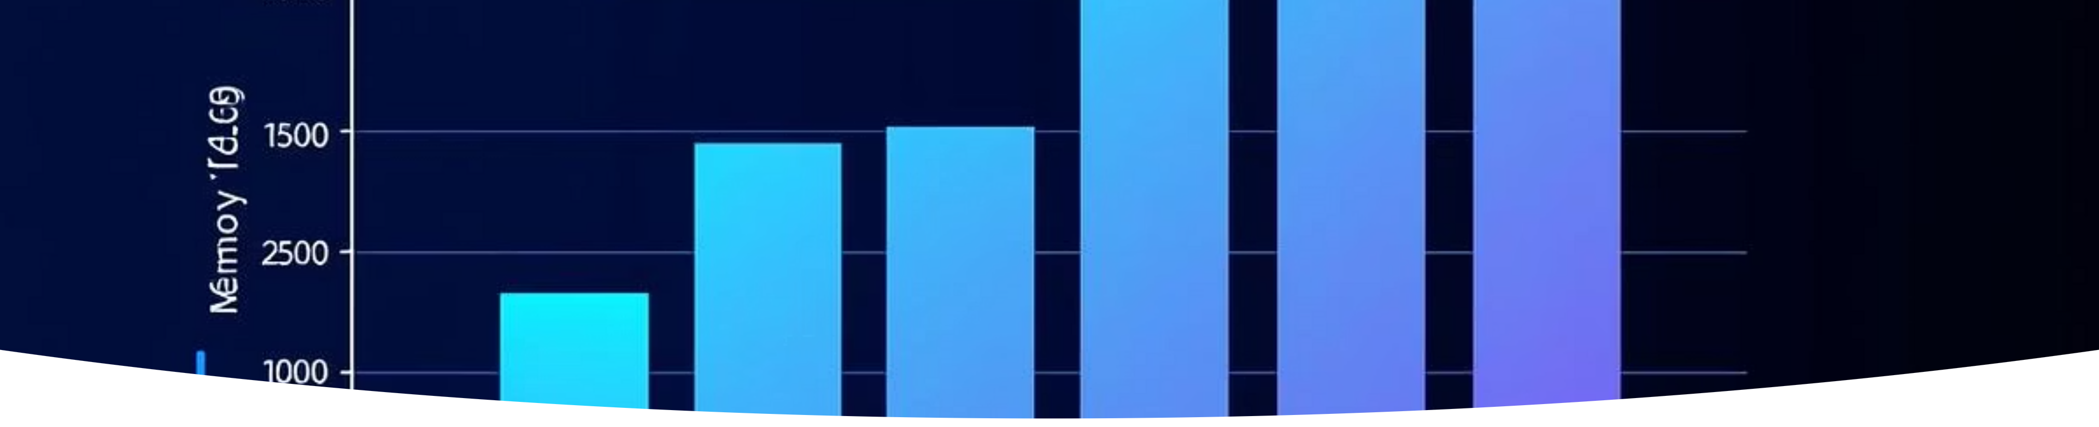
PERFORMANCE COMPARISON
Memory Utilization:
External Fragmentation:
Allocation Speed:
Best Fit: 85.6% (Highest)
Buddy System: Fastest
Buddy System: 92.3% (With internal waste)
Buddy System: 1.8% (Lowest)
First Fit: Fast
Best Fit: 4.3%
Best Fit: Slowest
Worst Fit: 72.8% (Lowest)
First Fit: 12.5%

Slide 7
KEY OBSERVATIONS
FIRST FIT:
BEST FIT:
✓ Fast allocation
✓ Best memory utilization
✗ Creates fragmentation at beginning
✗ Creates tiny unusable fragments
WORST FIT:
BUDDY SYSTEM:
✓ Leaves large free blocks
✓ Fastest, minimal external fragmentation
✗ Poor memory utilization
✗ Internal fragmentation (up to 50%)
CONCLUSION: No single best algorithm

Slide 8



LEARNING OUTCOMES
VISUAL LEARNING:
SYSTEM UNDERSTANDING:
INTERACTIVE EXPLORATION:
See algorithms in action
Trade-offs between algorithms
Understand fragmentation visually
Memory efficiency concepts
Hands-on experimentation
Real-world OS simulation
Customizable parameters
Compare real-time performance
Immediate feedback

Slide 9

SYSTEM DETAILS
MEMORY CONFIGURATION:
PROCESS CHARACTERISTICS:
DEPLOYMENT:
Local: streamlit run streamlit_app.py
Default: 1024KB (1MB)
Size: 16KB - 1024KB
Range: 256KB - 8192KB
Duration: 1-300 seconds
Cloud: https://danial1221-os-project.streamlit.app
Block granularity per algorithm
States: NEW, READY, RUNNING, TERMINATED

Slide 10

HOW TO USE THE SYSTEM
BASIC OPERATION:
COMPARING ALGORITHMS:
Select algorithm from sidebar
Test with First Fit
Configure memory size
Clear processes
Click "Initialize Memory"
Test with Best Fit
Add processes (Manual/Batch/Auto)
Compare results
Monitor real-time visualization
Free processes as needed

Slide 11
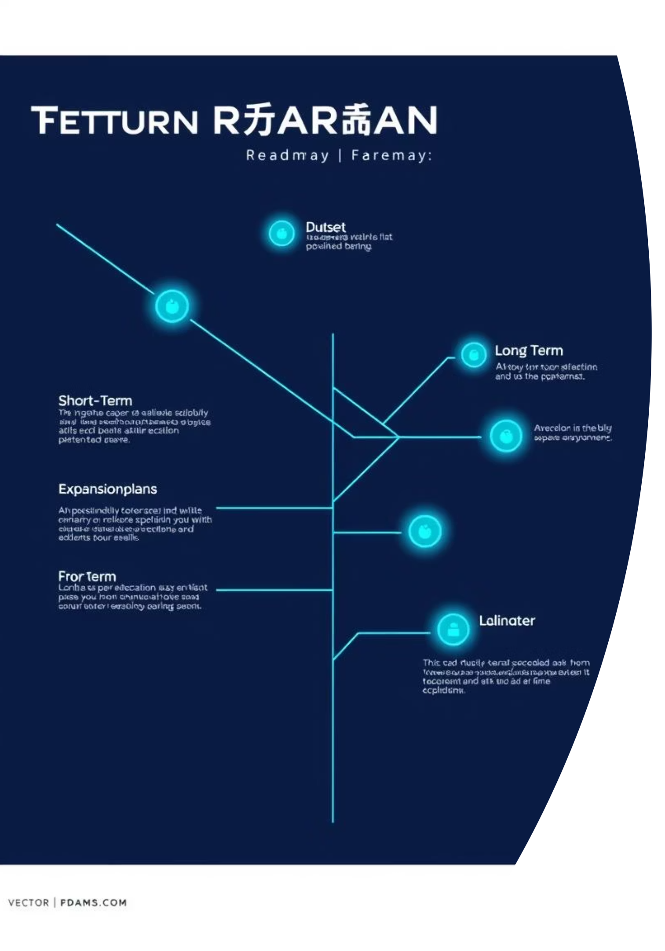
PLANNED FEATURES
SHORT-TERM:
LONG-TERM:
EXPANSION:
Page replacement algorithms (FIFO, LRU)
Multi-level algorithms
Add segmentation support
Performance profiling
Network distribution simulation
Virtual memory simulation
Dark mode theme
Export reports (PDF/CSV)
Undo/Redo functionality

Slide 12

DEVELOPMENT CHALLENGES
Mobile application version
1. REAL-TIME VISUALIZATION
2. ALGORITHM ACCURACY
3. STATE MANAGEMENT
Challenge: Maintaining session state across interactions
Challenge: Keeping UI responsive during heavy computation
Challenge: Ensuring correct implementation of all 5 algorithms
Solution: Leveraged Streamlit's session state features
Solution: Used Plotly with Streamlit's caching mechanism
Solution: Extensive testing with known edge cases

Slide 13
EDUCATIONAL VALUE
4. DEPLOYMENT Challenge: Cloud deployment with dependencies Solution: Streamlit Cloud with proper requirements.txt
FOR STUDENTS:
FOR INSTRUCTORS:
Practical understanding of OS concepts
Teaching aid for memory management
Visual reinforcement of theoretical knowledge
Demonstration tool for algorithm differences
Interactive learning experience
Assignment platform for students
TECHNICAL CONTRIBUTION:
Open-source educational tool
Modular, extensible architecture

Slide 14

DEMONSTRATION TIME
Real-world simulation platform
WHAT WE'LL SHOW:
KEY POINTS TO OBSERVE:
Launching the application
Adding processes manually
Real-time updates
Using auto-generation mode
Algorithm differences
Switching between algorithms
Fragmentation patterns
Observing fragmentation
Performance comparison

Slide 15

QUESTIONS & ANSWERS
Memory utilization trends
CONTACT INFORMATION:
PROJECT LINKS:
Musa Bin Abdullah: 233576
Live Application: https://danial1221-os-project.streamlit.app
Muhammad Danial: 233588
GitHub Repository: https://github.com/danial1221/Os-project
Documentation: Included in report

